Slide 1
Marketing & Value Chain
Business Management for IT
(IT3090)

Slide 2
Learning Outcome
Describe and Demonstrate the concepts and process of marketing and application of marketing concepts in the real world situations.
Describe the Value Chain

Slide 3
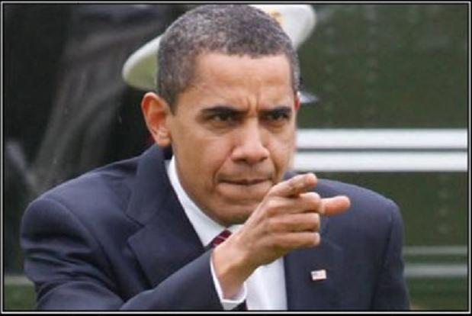
What is marketing?
How can you explain marketing in your perspective?

Slide 4
Definitions for Marketing
“Marketing is the management process that identifies, anticipates and satisfies customer requirements profitably.”
(Chartered Institute of Marketing (CIM)
Marketing is an activity of creating, communicating, delivering, and exchanging offerings that have value for customers.

Slide 5

Why IT Professionals Need Marketing?

Slide 6
Role of Marketing in a Business
Establishing relationships between customers and the organizations offering to the market.
Marketing shapes the image of the organization
Marketing is responsible for the increase in revenue and by extension increase in the organizations profitability.

Slide 7

Who is the customer?
A customer is an individual or business that purchases the goods or services produced by a business.

Slide 8

Customer Vs Consumer
Customers are the ones who purchase your products.
Consumers are the ones who actually use your products so the customer may not be the actual consumer of your product.

Slide 9
Marketing Mix – 4Ps The marketing mix elements that make up an organization’s marketing program:
Product
Promotion
Price
Place
These are management decisions, controllable factors

Slide 10
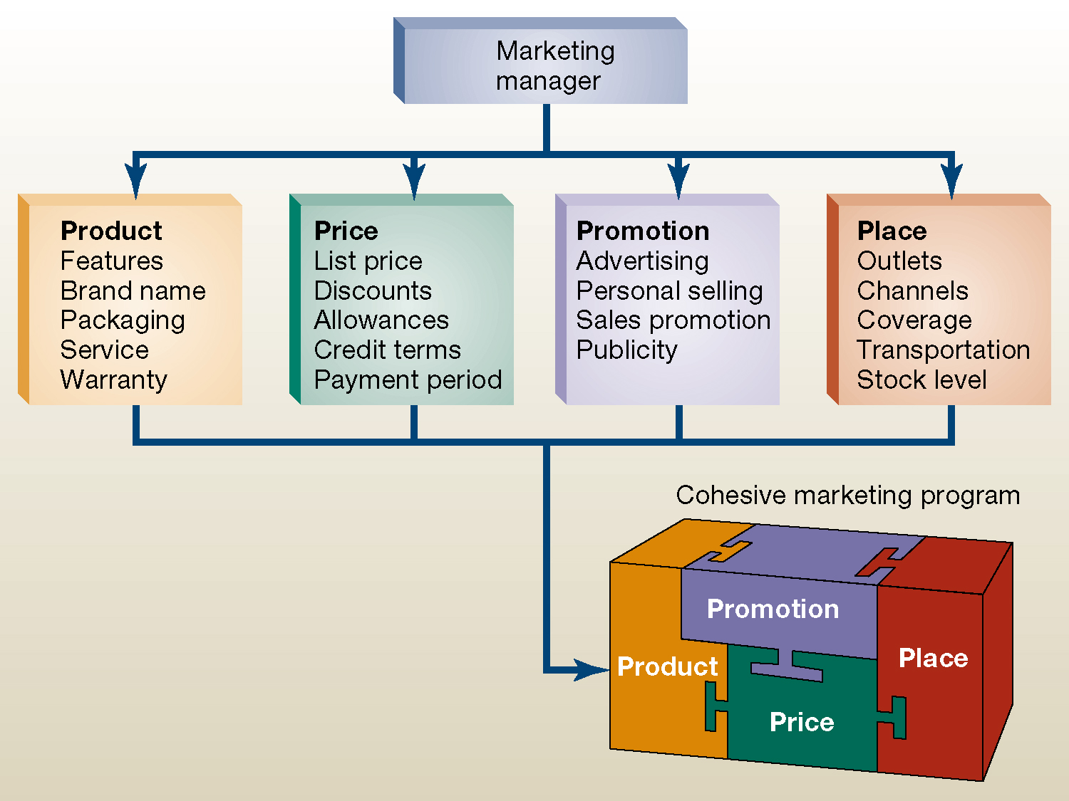
The Marketing “Mix”

Slide 11
Value Chain

Slide 12
Value Addition/Creation
Value is the capacity of a good, work or service to meet a particular want

Slide 13
Porter’s value chain
The term value chain was used by Michael Porter (1985)
A value chain is a business model that describes the full range of activities needed to create a product or service.
The purpose of a value-chain analysis is to increase production efficiency so that a company can deliver maximum value for the least possible cost.

Slide 14
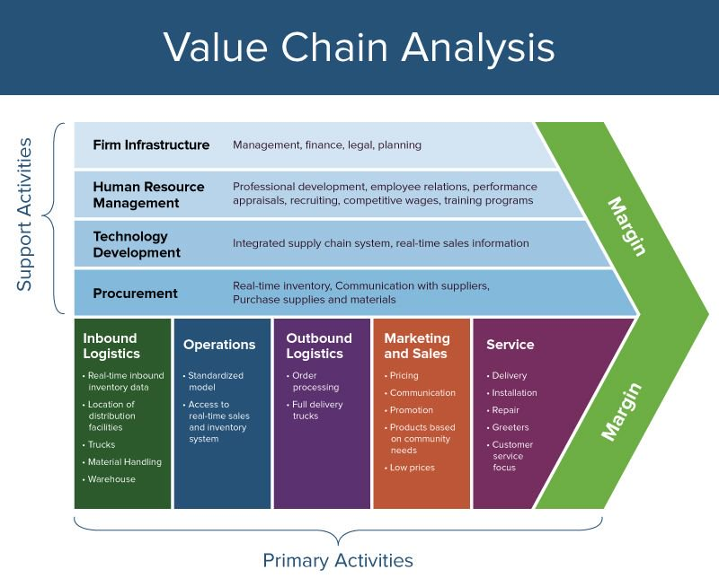

Slide 15
Primary activities
Distinguishes between primary and support activities
Primary activities are directly concerned with the creation or delivery of the product or service
Can be grouped into five main areas:
Inbound logistics
Operations
Outbound logistics
Marketing and sales
service

Slide 16
VALUE CHAIN: PRIMARY ACTIVITIES
There are generally five primary activities
Inbound logistics
Raw materials, components, services, etc. are supplied and input to the organisation. Activities include storage, warehousing, returns to suppliers, material handling and vehicle scheduling.
Operations
Value is generated by transforming inputs into the final product and/or service. The activities can include machining, assembly, information processing and inspection.
Outbound logistics
The process through which buyers receive the final product and/or service. Activities include materials handling, transportation, order processing and finished good storage.

Slide 17
VALUE CHAIN: PRIMARY ACTIVITIES
Marketing and sales
How the organisation induces buyers to purchase the goods and services. It includes the activities of advertising, promotion, pricing, sales force logistics and channel management.
Service
The way in which the product is maintained or enhanced in value with after sales, e.g. activities of installation, repair, training and on-site product adjustment.

Slide 18
Support activities (Secondary)
Each of the primary activities is linked to support activities which help to improve their effectiveness or efficiency
The four support activities are:
Procurement
technology development (including R&D)
Human resource management
Infrastructure ( systems for planning, finance, quality, information management etc)

Slide 19
VALUE CHAIN: SECONDARY ACTIVITIES
Consists of generally four main activities
Procurement
Purchased inputs such as raw materials and organisational assets such as machinery and computers. It can also include those purchasing activities associated with employing consultant firms or an accountant’s services. This activity is dispersed throughout the value chain activities in both the support and primary activities. Some form of purchasing, however small and trivial, can be identified for each activity.
Technology development
Technology development also plays a crucial role in adding value to many activities. It can take on many forms, from basic research and product design to information technology for after-sales servicing, order entry and other administrative tasks.

Slide 20
VALUE CHAIN: SECONDARY ACTIVITIES - 2
Human resource management
This activity mainly concerns recruiting, dismissing and training of all types of personnel. It too is dispersed throughout the organisations although a central personnel or HR department is found in many large organisations. It can be a key source of competitive advantage for professional service firms such as IBM who globally coordinate the recruitment and training of staff to meet the needs of large global customers.
Firm infrastructure
This is concerned with general management/leadership style, strategic planning, accounting and corporate affairs. It is expected that these activities are common throughout the organisation supporting the whole chain. For example Total Quality Management (TQM) programmes are increasingly associated with the firm’s infrastructure and permeate the whole organisation.

Slide 21
End

